Slide 1
Student Performance
Prediction Using Machine Learning
Regression study using the UCI Student Performance dataset
Prepared by Mule Mohan Reddy • B.Tech CSE • IIIT Sri City

Slide 2
Problem Statement & Objectives
2
• Predict the final Mathematics grade (G3) using student characteristics and previous academic information.
• Explore relationships between attendance, study time, previous grades and final grade.
• Build and compare Linear Regression and Random Forest Regression models.
• Evaluate models using MAE, RMSE and R².
• Save the trained model and prediction outputs for reuse.
Student Performance Prediction • UCI Mathematics Dataset

Slide 3
Dataset
3
Dataset
UCI Student Performance
File
student-mat.csv
Records
395 students
Columns
33
Target
G3 – Final Grade
Task
Regression • Grade 0–20
Student Performance Prediction • UCI Mathematics Dataset

Slide 4
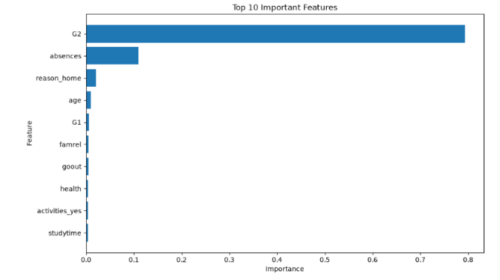
Final Grade Distribution
4
Distribution of final Mathematics grades (G3).
Student Performance Prediction • UCI Mathematics Dataset

Slide 5
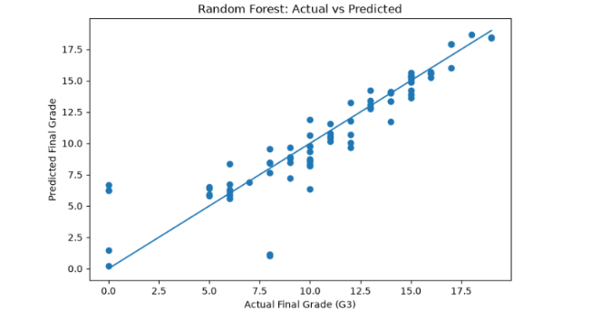
Absences vs Final Grade
5
Descriptive view of the relationship between absences and G3.
Student Performance Prediction • UCI Mathematics Dataset

Slide 6
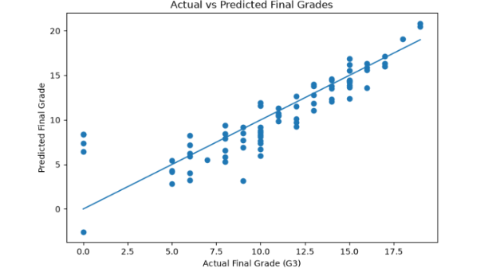
Study Time vs Final Grade
6
Final-grade distributions across study-time categories.
Student Performance Prediction • UCI Mathematics Dataset

Slide 7
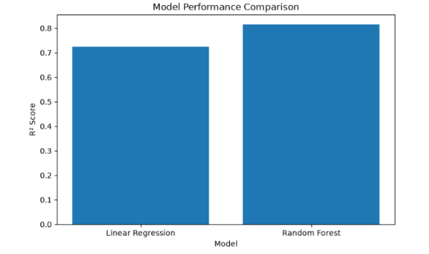
G2 vs G3
7
G2 shows a strong relationship with the final grade G3.
Student Performance Prediction • UCI Mathematics Dataset

Slide 8
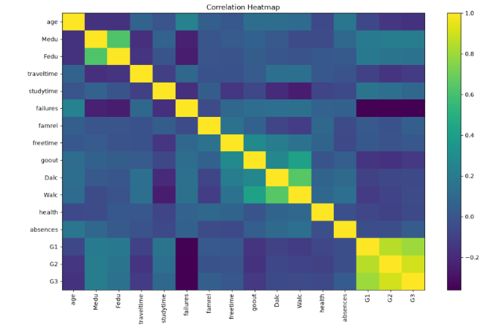
Correlation Heatmap
8
Correlation structure among the numerical variables.
Student Performance Prediction • UCI Mathematics Dataset

Slide 9
Preprocessing & Workflow
9
1
2
3
4
5
6
Load
Inspect
Encode
Split
Train
Evaluate
student-mat.csv
shape, types, missing values
one-hot categorical variables
80% train / 20% test
Linear Regression + RF
MAE, RMSE, R²
Feature matrix: 395 × 32 → after one-hot encoding: 395 × 41
Train: 316 samples | Test: 79 samples | random_state = 42
Student Performance Prediction • UCI Mathematics Dataset

Slide 10
Model Results
10
Model
MAE ↓
RMSE ↓
R² ↑
Linear Regression
1.647
2.378
0.724
Random Forest
1.165
1.949
0.815
Observed test-set results: Random Forest has lower MAE/RMSE and higher R² in this experiment.
Student Performance Prediction • UCI Mathematics Dataset

Slide 11
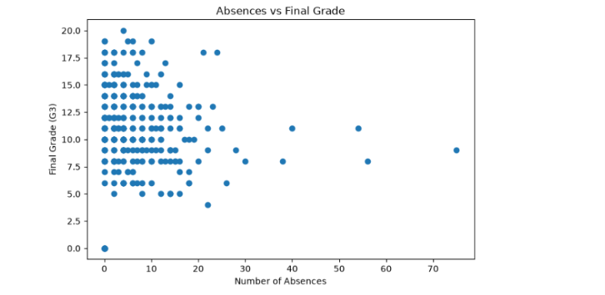
Model Performance Comparison
11
R² comparison between Linear Regression and Random Forest.
Student Performance Prediction • UCI Mathematics Dataset

Slide 12
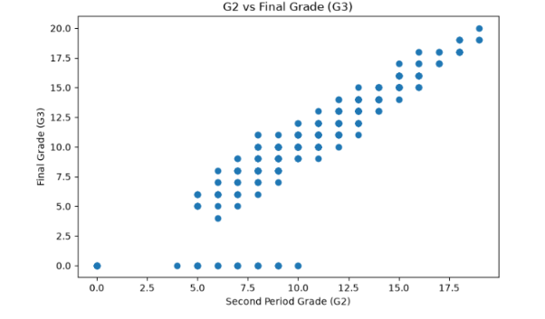
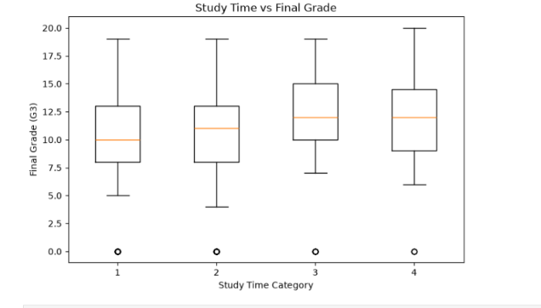
Actual vs Predicted
12
Linear Regression
Random Forest
Student Performance Prediction • UCI Mathematics Dataset

Slide 13
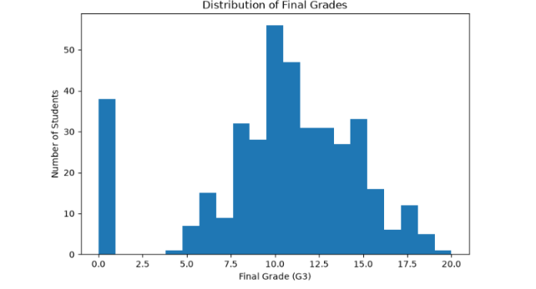
Feature Importance
13
Top 10 Random Forest features; importance indicates predictive contribution, not causation.
Student Performance Prediction • UCI Mathematics Dataset

Slide 14
Model Saving / Outputs
14
Saved model
student_performance_model.pkl
Prediction output
prediction_results.csv
Comparison output
model_comparison.csv
Reload test
[8.32, 11.78, 6.50, 9.76, 8.80]
Student Performance Prediction • UCI Mathematics Dataset

Slide 15
Limitations & Future Scope
15
Limitations
Future Scope
• 395 students from two Portuguese schools.
• G1 and G2 are included, so this is not an early-warning prediction setting.
• Results use one 80:20 train-test split.
• Predictive relationships do not prove causation.
• Performance may change on other populations.
• Run an early-prediction experiment excluding G1 and G2.
• Use k-fold cross-validation.
• Tune Random Forest hyperparameters.
• Compare Gradient Boosting, SVR and other regressors.
• Use larger and more diverse datasets.
Student Performance Prediction • UCI Mathematics Dataset

Slide 16
Conclusion
• A complete machine-learning workflow was developed for predicting final Mathematics grade G3.
• Linear Regression: MAE 1.647, RMSE 2.378, R² 0.724.
• Random Forest: MAE 1.165, RMSE 1.949, R² 0.815.
• The experiment shows lower observed errors and higher explained variation for Random Forest on this test split.
• G1 and G2 are important previous-grade predictors, so the task should be interpreted as final-grade prediction with prior academic information.
Thank You

